Slide 1
ATOMIC MODEL
J.J Thomson,Ernest Rutherford

Slide 2
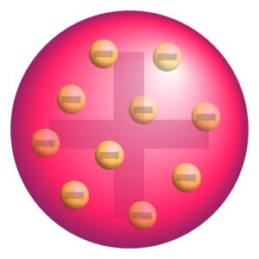
Thomson’s Atomic Model
In 1898, J. J. Thomson proposed the first of many atomic models to come.
He proposed that an atom is shaped like a sphere with a radius of
approximately 10⁻¹⁰m, where the positive charge is uniformly distributed.
The electrons are embedded in this sphere so as to give the most stable
electrostatic arrangement.

Slide 3
Doesn’t the figure above remind you of a cut watermelon with seeds inside? Or, you can also think of it as a pudding with the electrons being the plum or the raisins in the pudding. Therefore, this model is also referred to as the watermelon model, the plum pudding model or the raisin pudding model.
An important aspect of this model is that it assumes that the mass of the atom is uniformly distributed over the atom. Thomson’s atomic model was successful in explaining the overall neutrality of the atom. However, its propositions were not consistent with the results of later experiments. In 1906, J. J. Thomson was awarded the Nobel Prize in physics for his theories and experiments on electricity conduction by gases.

Slide 4
CONTRIBUTIONS:
➔He did groundbreaking work in conduction of electricity in gases
➔Sir J J Thomson discovered the electron
➔His cathode ray experiments aided the invention of the first televisions
➔He discovered the first evidence of different isotopes in a stable element
➔His treatise on the motion of vortex rings is a seminal text on the subject
➔Thomson proposed the plum pudding model of the atom

Slide 5
Rutherford Atomic Model
The second of the atomic models was the contribution of Ernest Rutherford. To come up with their model, Rutherford and his students – Hans Geiger and Ernest Marsden performed an experiment where they bombarded very thin gold foil with α-particles. Let’s understand this experiment.

Slide 6
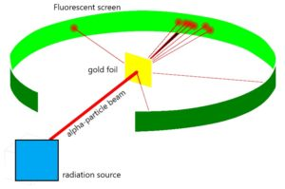
α-Particle Scattering Experiment
Experiment
In this experiment, high energy α-particles from a radioactive source were directed at a thin foil (about 100nm thickness) of gold. A circular, fluorescent zinc sulfide screen was present around the thin gold foil. A tiny

Slide 7
Results
Based on Thomson’s model, the mass of every atom in the gold foil should be evenly spread over the entire atom. Therefore, when α-particles hit the foil, it is expected that they would slow down and change directions only by small angles as they pass through the foil. However, the results from Rutherford’s experiment were unexpected –
Most of the α-particles passed undeflected through the foil.
A small number of α-particles were deflected by small angles.
Very few α-particles (about 1 in 20,000) bounced back.

Slide 8
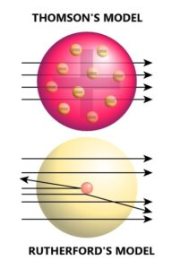
Thomson’s model versus Rutherford’s model

Slide 9
Conclusions of the α-scattering experiment
Based on the above results, Rutherford made the following conclusions about the structure of the atom:
Since most of the α-particles passed through the foil undeflected, most of the space in the atom is empty.
The deflection of a few positively charged α-particles must be due to the enormous repulsive force. This suggests that the positive charge is not uniformly spread throughout the atom as Thomson had proposed. The positive charge has to be concentrated in a very small volume to deflect the positively charged α-particles.
Rutherford’s calculations show that the volume of the nucleus is very small compared to the total volume of the atom and the radius of an atom is about 10⁻¹⁰m, while that of the nucleus is 10⁻¹⁵m.

Slide 10
Contributions:
➔He discovered the principle of half-life and applied it to radiometric dating
➔Rutherford discovered that atoms were not indestructible
➔He formulated the Rutherford model of the atom in 1911
➔Ernest Rutherford discovered the atomic nucleus
➔He discovered the proton in 1917
➔He theorized the existence of the neutron
➔He is known as the father of nuclear physics

